Slide 1


Harshit-Learn
AI-Powered Future Learning with AR/VR, AI Guidance & Peer-to-Peer Skill Exchange
Learn • Build • Share • Grow
Designed & Developed by Bhalani Harshit

Slide 2







Founder & Developer
Bhalani Harshit
Full-Stack Developer | AI & ML Enthusiast
Engineering Student dedicated to building scalable tech platforms and exploring the frontiers of Artificial Intelligence.
Artificial Intelligence
Full-Stack Development
Scalable Tech

Slide 3






AR/VR Immersive Learning Experience
Learn physics, history, and engineering using immersive simulations and virtual labs.
Virtual Labs
Historical Simulations
Hands-on experiments in safe virtual environments.
Experience historical events and periods firsthand.
Engineering Models
Understand complex machinery and systems through 3D visualization.

Slide 4
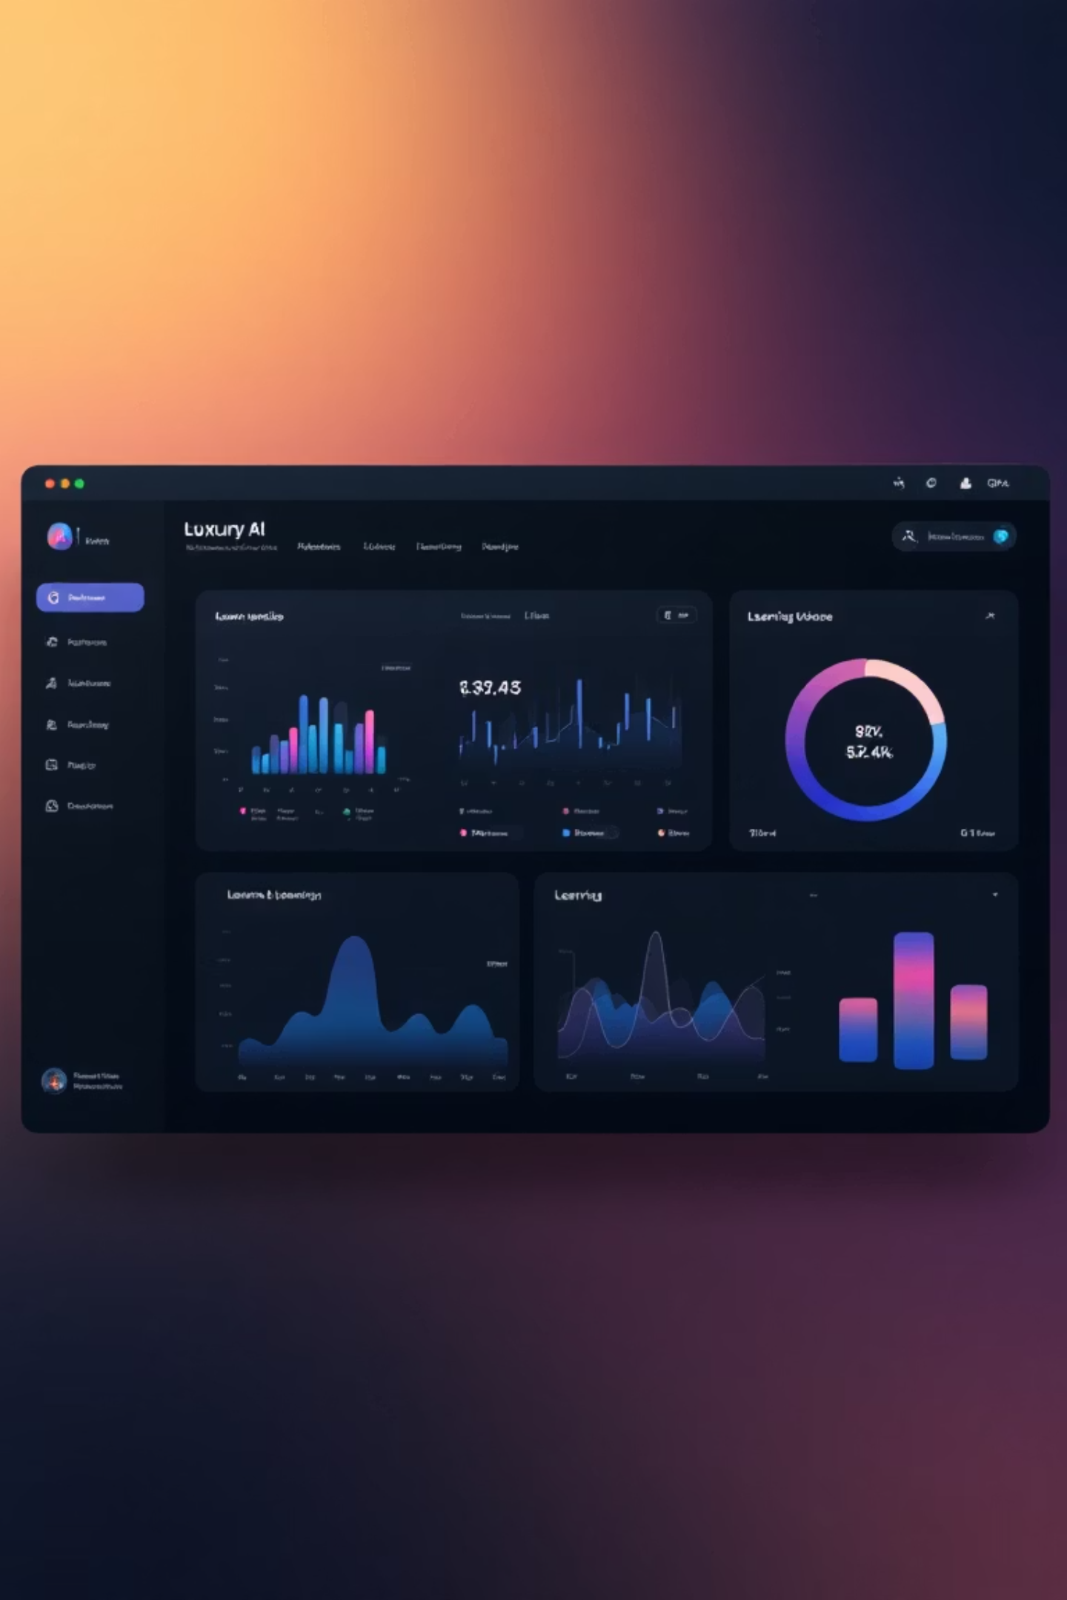





AI Teaching Assistant - Your Personal Learning Guide
AI analyzes your progress and recommends personalized learning paths in real time.
Real-time Progress Analysis
AI monitors your learning patterns and identifies knowledge gaps.
Personalized Recommendations
Get course suggestions tailored to your learning style and goals.
Adaptive Learning Paths
Content difficulty adjusts based on your performance.
24/7 Support
Always available to answer questions and guide your learning journey.

Slide 5



Skill Barter Marketplace - Exchange Skills Globally
Exchange your skills like coding, design, photography, or marketing without money.
Alex Morgan
David Chen
Maria Rodriguez
Frontend Developer
UI/UX Designer
Data Scientist
Offering: Advanced React patterns
Seeking: UI/UX Design principles
Offering: UI/UX Design mentorship
Seeking: Python for Data Science
Offering: ML model development
Seeking: Spanish Conversation

Slide 6



Student Testimonials - Real Success Stories
James Wilson - Engineering Student
Sophia Lee - Data Science Bootcamp
Carlos Mendez - Medical Student
"The VR engineering labs transformed how I understand complex concepts. It's like being inside the machine!"
"Trading my design skills for Python lessons was a game-changer. The skill marketplace is brilliant!"
"The AI learning assistant identified my weak areas and created a personalized study plan. My grades improved by 30%!"

Slide 7





Your Learning Journey - Four Simple Steps
Start your future learning journey in four simple steps.
Create Account & Set Goals
Sign up and define your learning objectives, interests, and skill level.
Learn with AR/VR & AI Mentor
Access immersive learning modules guided by your personal AI assistant.
Track Progress with Analytics
Monitor your improvement with detailed insights and performance dashboards.
Exchange Skills Globally
Connect with learners worldwide to exchange skills and knowledge.

Slide 8



Explore Harshit-Learn Today
Ready to experience the future of learning? Visit the live project and start your learning journey now. The platform is fully functional with AR/VR experiences, AI-powered guidance, and a thriving skill exchange community.

Slide 9




Contact Details
Get in touch for collaborations, internship opportunities, or project inquiries.
Phone
9510496083
Email
hbhalanii937@gmail.com
Project
Harshit-Learn

Slide 10

The Problem in Today’s Learning System
Traditional education models are struggling to keep pace with the rapidly evolving digital economy.
Passive Learning
Gap in Practical Skills
Current platforms are often one-way and lack interactive engagement.
Students lack exposure to real-world, skill-based practical applications.
Isolated Ecosystems
Static Tracking
Lack of strong community-driven skill-exchange environments.
Difficult to monitor real progress with limited AI-driven guidance.

Slide 11
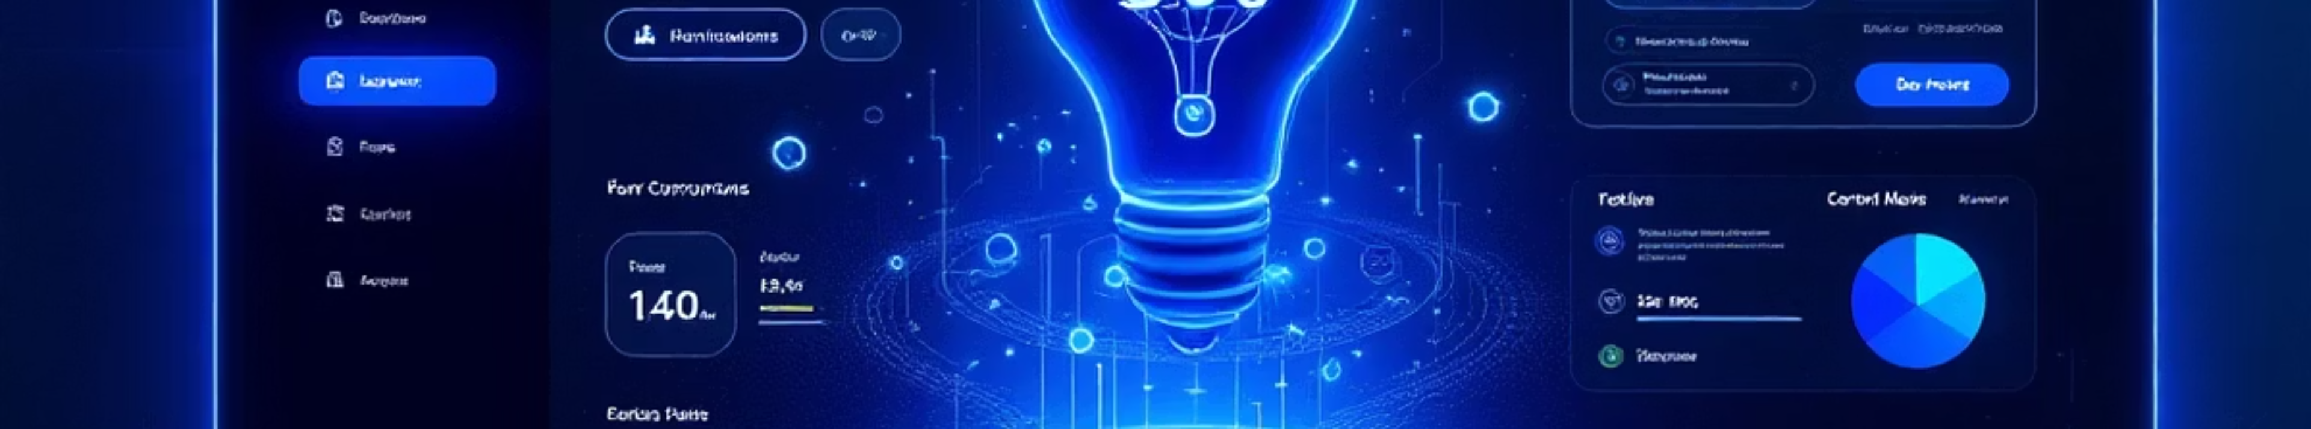
Our Solution: Harshit-Learn
A comprehensive AI-powered ecosystem designed to bridge the gap between knowledge and mastery.
Skill-Based Learning
Empowering Providers
Interactive modules focused on practical execution.
Enables experts to create, publish, and monetise courses.
AI Personalisation
Verified Growth
Smart algorithms tailor learning paths to individual needs.
Real-time tracking and industry-standard certifications.

Slide 12






Key Features
Secure Auth
Course Publishing
Robust JWT-based authentication for data security.
Seamless tools for creating and sharing knowledge.
Progress Tracking
AI Experience
Visual analytics to monitor your learning journey.
Intelligent guidance throughout the platform.
Certifications
Dual Roles
Earn rewards for completing milestones.
Dedicated portals for Students and Skill Providers.

Slide 13
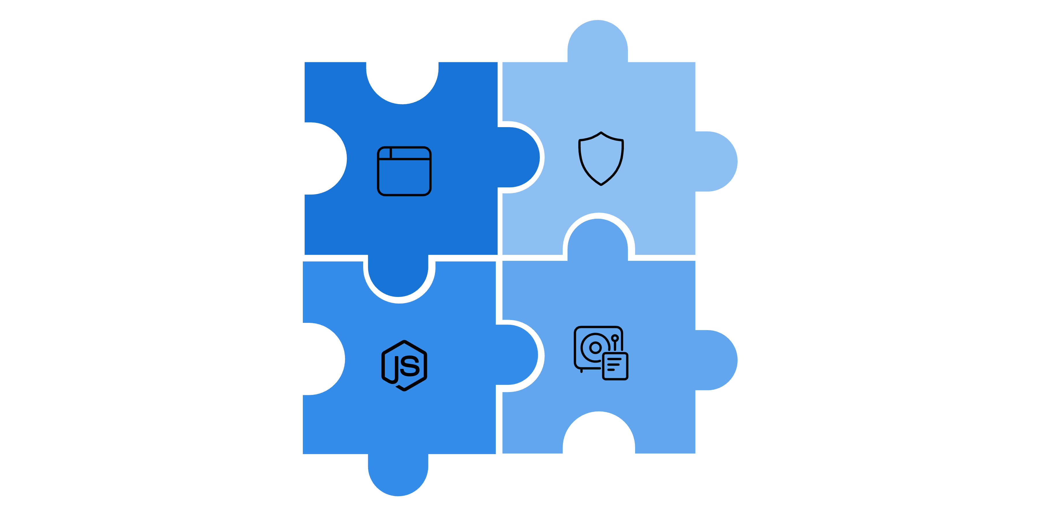




Technology Stack
Built with a modern, scalable architecture to ensure high performance and reliability.
Frontend
Database
HTML, CSS, JavaScript
MongoDB (NoSQL)
Backend
Security
Node.js, Express.js
JWT Authentication
Web Frontend
JWT Security
Node.js API
MongoDB
Architecture: REST APIs | Deployment: Scalable & Modular

Slide 14
Platform Workflow
01
02
03
Registration
Role Selection
Course Management
Secure user signup and login.
Choose between Student or Skill Provider.
Publishing or enrolling in courses.
04
05
Active Learning
Completion
Progress tracking and content consumption.
Final assessment and certificate generation.

Slide 15

Smart Certification System
Auto-generated digital certificates
Unique Certificate ID for verification
Professional, LinkedIn-shareable design
Proof of skill & course completion
Startup-grade credibility

Slide 16




The Future of Learning is Here.
Harshit-Learn
Thank you for your time. Let's build the future together.
"Innovation distinguishes between a leader and a follower." — Harshit-Learn Vision

